Slide 1

Credit card fraud
By:
Cody Lerch, Debasis Pradhan, Elena Gehle, Isaac Fonseca, and Warren Simmons
Notes:
10/27/24

Slide 2

Analysis report of credit card fraud
Introduction
This report presents an analysis of credit card fraud. Currently, 60% of U.S. credit card holders have been hit by fraud, and almost half
of them multiple times. Last year alone, 52 million Americans dealt with fraudulent charges adding up to over $5 billion. The median
amount for a fraudulent charge has jumped 26% in the past two years, going from $79 to $100. Only 7% of these fraudulent charges
involve physically stolen or lost cards—the rest are from accessing personal data and account info remotely. And it doesn't help that
most cardholders engage in risky behaviors that make their accounts more vulnerable. The thing that stands out is how prevalent
online fraud is compared to traditional card theft. Only 7% of fraudulent charges come from physically stolen or lost cards. The
remaining 93%? Those are remote attacks on personal data and account info. It’s like a silent thief slipping through your digital door.
Today it is known that four out of five cardholders admitting to it means a huge number of people are inadvertently making themselves targets.
Notes:
10/27/24

Slide 3

Cleaning procedure
Notes:
10/27/24

Slide 4
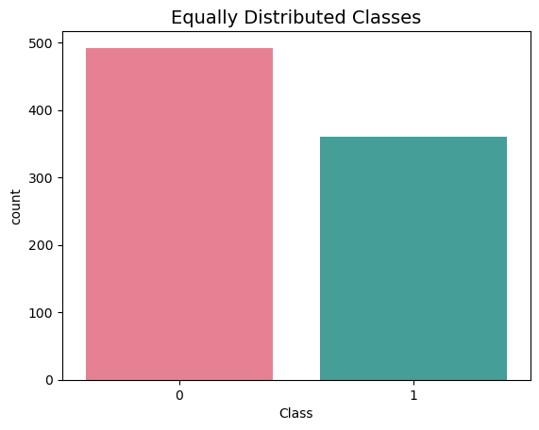
distribution of sub sample classes
0 0.577465
1 0.422535
Notes:
10/27/24

Slide 5
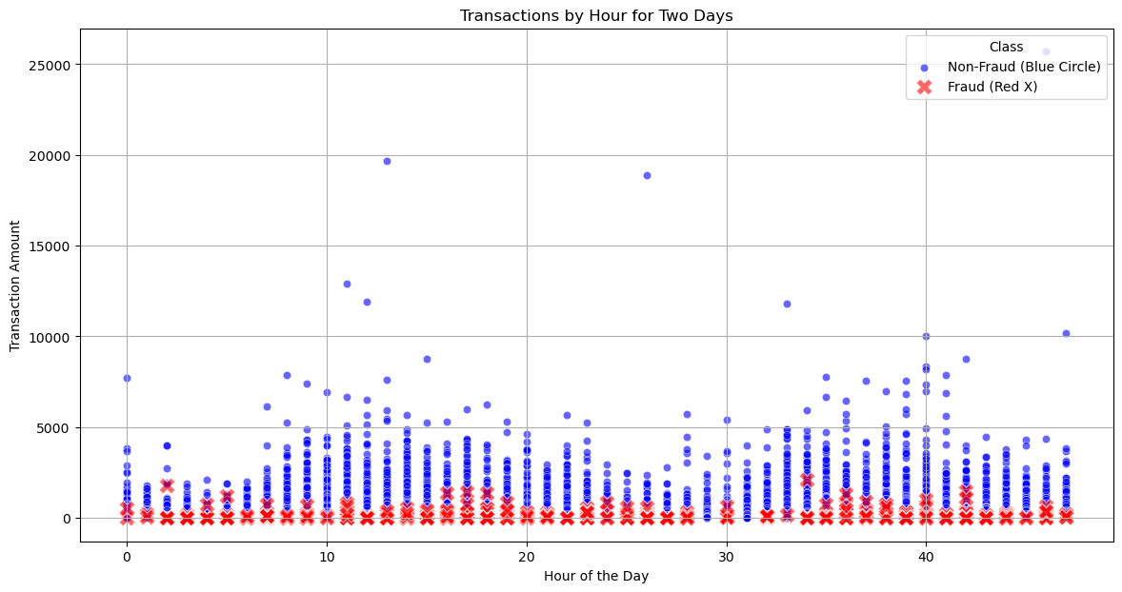
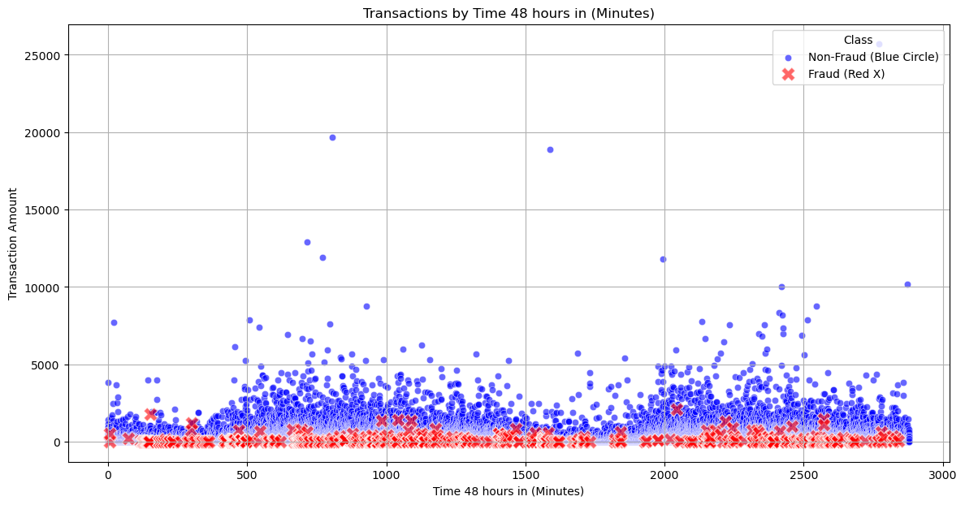
scatter plot by hour and minute
Notes:
10/27/24

Slide 6
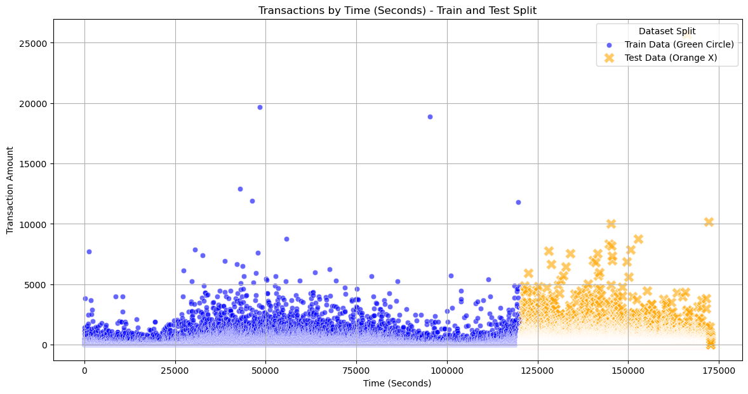
train and test split
Notes:
10/27/24

Slide 7
Predictive Models considered
Logistic Regression
Decision Tree: DecisionTreeClassifier

Slide 8
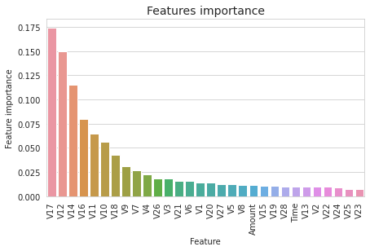
Predictive Models considered
Random Forest: RandomForestClassifier
Gradient Boosting: GradientBoostingClassifier

Slide 9
Predictive Models considered
Support Vector Machine: SVC
ExtraTreesClassifier:

Slide 10
Predictive Models considered
KNN: KNeighborsClassifier

Slide 11

Credit card fraud Trends
Notes:
10/27/24

Slide 12
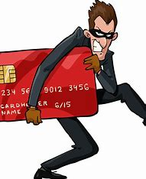
Executive Summary
Notes:
10/27/24

Slide 13
references
1). Gabriel Preda (2024) Credit Card Fraud Detection Predictive Models. https://www.kaggle.com/code/gpreda/credit-card-fraud-detection-predictive-models
2). Brett Cruz(2024, Jul 26) 52 Million Americans Experienced Credit Card Fraud Last Year. Securiety.org
3). RandomForrestClassifier, http://scikit-learn.org/stable/modules/generated/sklearn.ensemble.RandomForestClassifier.html
Notes:
10/27/24

